Slide 1
Data Extraction
Web Scraping

Slide 2
What is Data Extraction
Data extraction is the act of retrieving data from usually unstructured or poorly structured data sources into centralized locations for storage or further processing.
It’s the upstream process of Data Analysis

Slide 3
Goals of Data Extraction
Archival
Transfer the format of data
Data analysis

Slide 4
Steps in Data Extraction
Step 1: Select a data source
Choose the target data source you want to extract, such as a website.
Step 2: Data Collection
Send a “GET” query to the website and parse the HTML document of it with programming languages like Python, PHP, R, Ruby, etc.
Step 3: Data Storage
Store the data in your on-site database or a cloud based destination for future use.

Slide 5
What I did
I did a web scraping from the website https://www.timesjobs.com
It has job posts and I searched for ‘python’ which returned a lot of jobs in html format
I filtered out jobs posted few days ago and added a feature to neglect the jobs skill of which I don’t have.
The data was extracted into a text file
The text file was converted to a excel file (data crunching)

Slide 6
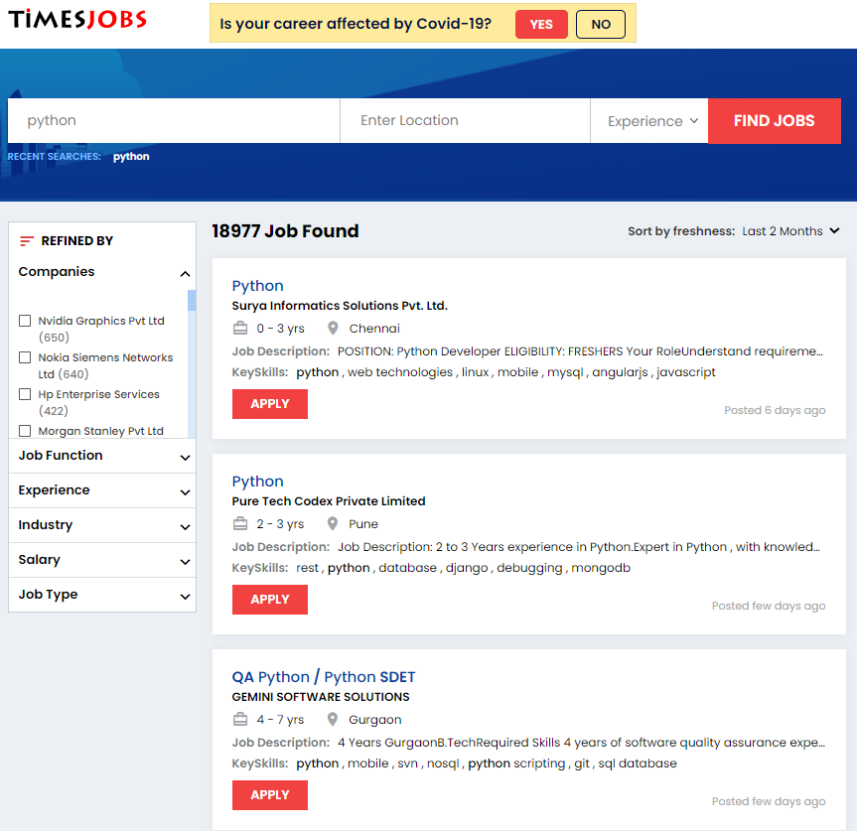
Step 1: Input Data
Figure 1: Input Data frontend

Slide 7
Step 2 : Data collection
BS4 ( Beautiful Soup Four), a python library, was used to extract data from the web page
GET request was used with the module “request”
Using html tags the required data was extracted

Slide 8
Step 3 : Data Storage
Data was kept in a text file
Later the text file was converted into an excel file

Slide 9
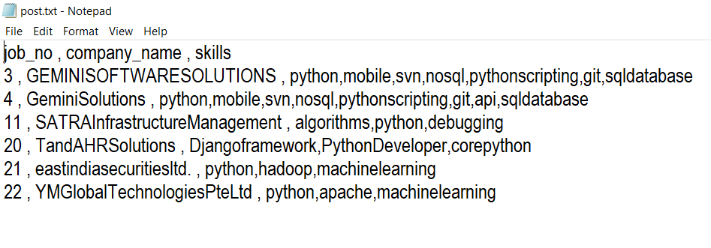
Output : Text File
Figure 2 : Text File Output

Slide 10
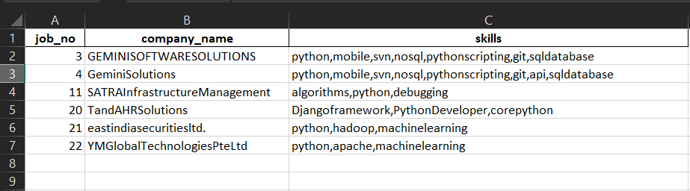
Output : Excel File
Figure 3 : Excel (xlsx) File Output

Slide 11
What I didn’t
No numerical data was extracted
No data analysis on the extracted data

Slide 12
Thank You

